Slide 1

Research Profiles of Academic Staff
Group 14
E/17/122 Shazna
E/17/153 Odasara
E/17/294 Mishel

Slide 2


Introduction
Computer Engineering Department does a vast number of research for an year.
Researches conducted by the department
Students' publications
Staff members' collaborative publications

Slide 3





Introduction
Areas of Researches
Operating Systems
Embedded Systems
Machine Learning
IoT
Image Processing
Computational Biology
Cryptography
Data Science

Slide 4


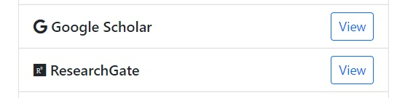
Introduction
Currently publications are available on,
Journals and Conference websites
Research Gate
Google Scholar

Slide 5





Problem Description
There is no single place where all of the publications are available
Unable to locate publications in the same category
No auto updating mechanism

Slide 6
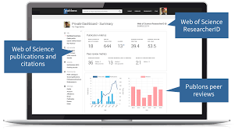
Solution
A web portal to collect all publications on all areas under Computer Engineering department to a single information repository.

Slide 7
Features
An auto updating web portal
Displays all CE publications
Separate user profiles for each researcher
Ability to find researches via keywords
Ability to sort (Date, Name)

Slide 8
Target Audience
Academic staff
Undergraduate students
Postgraduate students
Other researchers
International Organizations

Slide 9
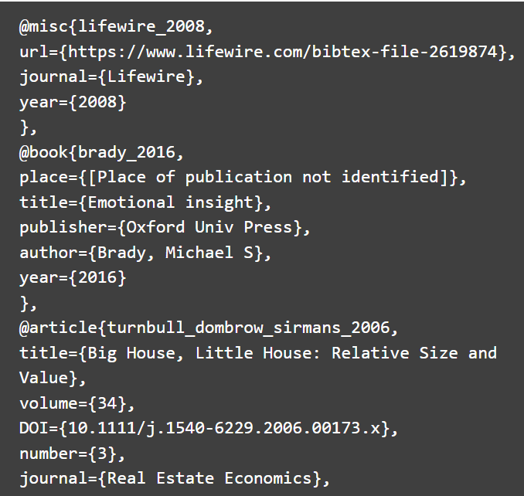


Data Collection
Bib File

Slide 10
Data Structure
Data Types
Publications
Title
Abstract
Subject
Authers
Year Published
Journal/ Conference Information
DOI
Grants
Professional Membership
Teaching & Supervision
These data are shown via a web widget.

Slide 11

Plan for Work
Identifying the Problem & Solution
Designing the Interface
Implementing Database, Frontend and Backend
Creating ML Model for tagging
Testing
Deploying
Maintaining

Slide 12
Success of the Project
Analysing number of viewers to the web site
Requesting feedbacks from the users

Slide 13

Future Plans
Extend the system to other departments, faculties and universities​

Slide 14
Team
Product Owners
Team
Dr.Damayanthi Herath
Dr.Janaka Alawatugoda
Mr.Nuwan Jaliyagoda
E/17/122 Shazna Isthikar
E/17/153 Odasara Karunachandra
E/17/294 Mishel Rossmaree
Scrum Master
Miss Dilshani Karunaratne

Slide 15
THANK YOU !

Slide 16
Q & A

